Slide 1



Structural Bioinformatics
Alexey Morgunov
Manifold Research Ltd. University of Cambridge, UK University of Tartu, Estonia

Slide 2
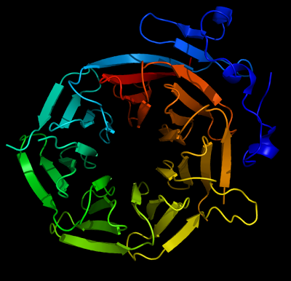
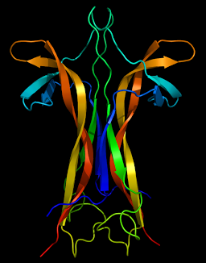
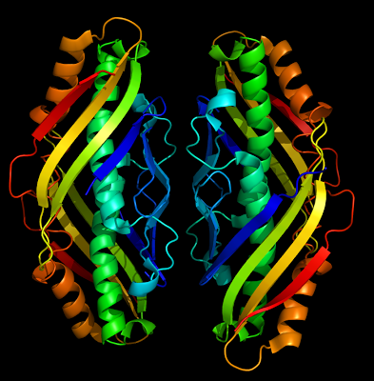
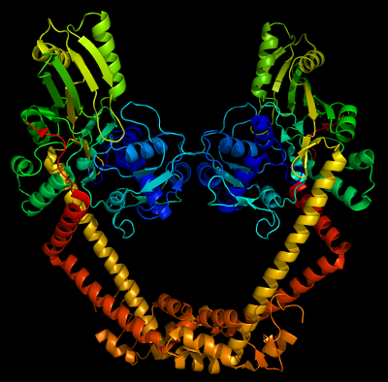
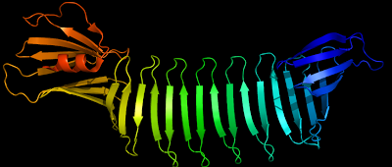
http://beautifulproteins.blogspot.co.uk/

Slide 3
Aims of this lecture
A superficial introduction to a large and diverse field of structural bioinformatics
Describing the landscape of resources available
Focus on what knowledge can be gained by analysing protein structures
Introducing some current directions and applications

Slide 4
What is structural bioinformatics?
Categorisation and descriptive analysis
Comparative methods and techniques
Theoretical foundations
Predictive and design capability

Slide 5
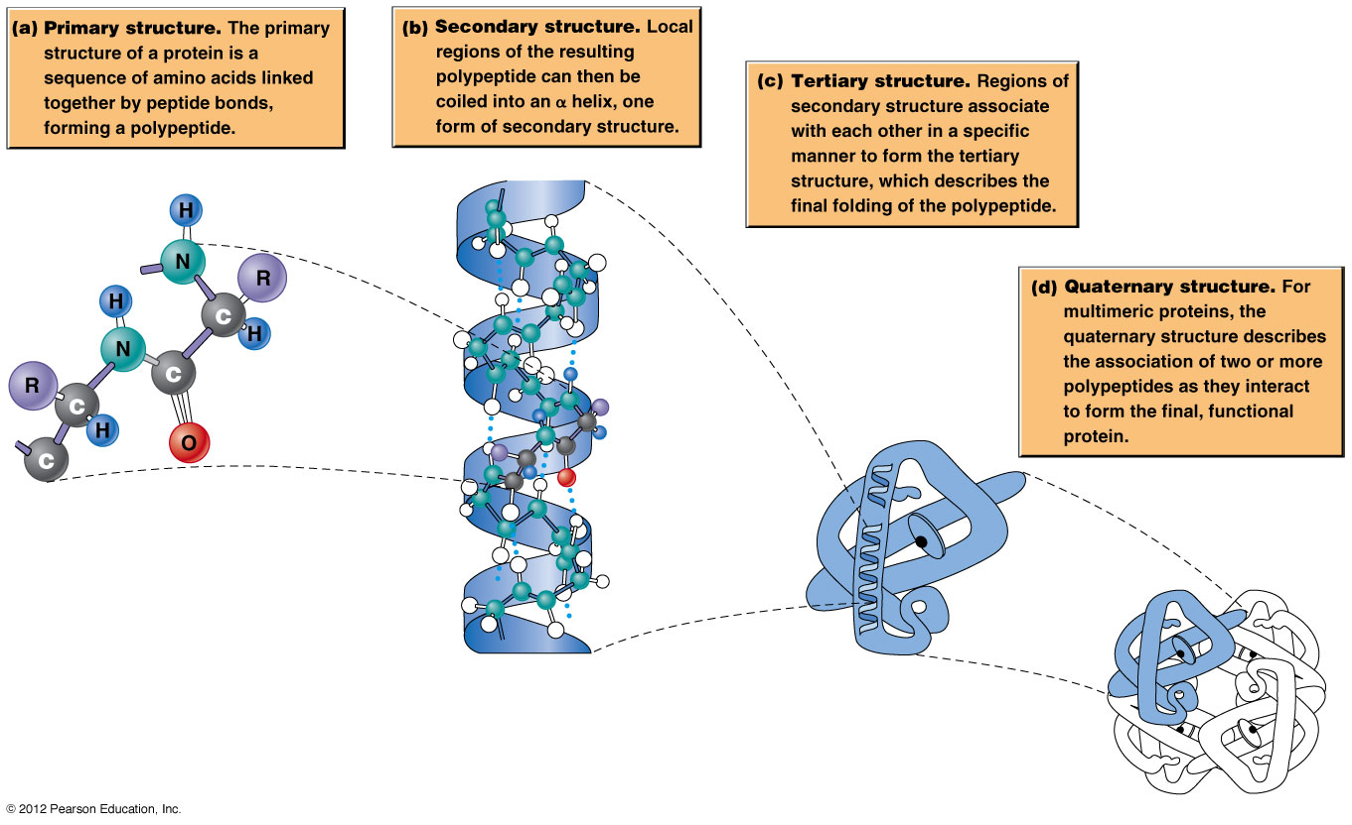
Protein structure refresher

Slide 6
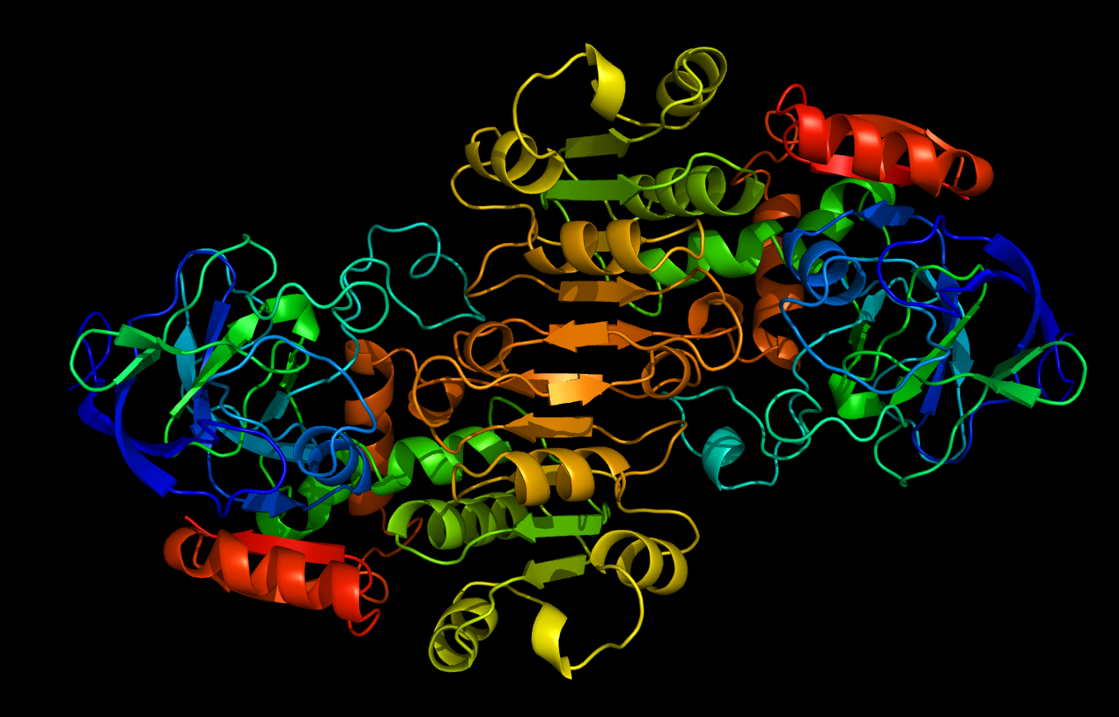

Slide 7
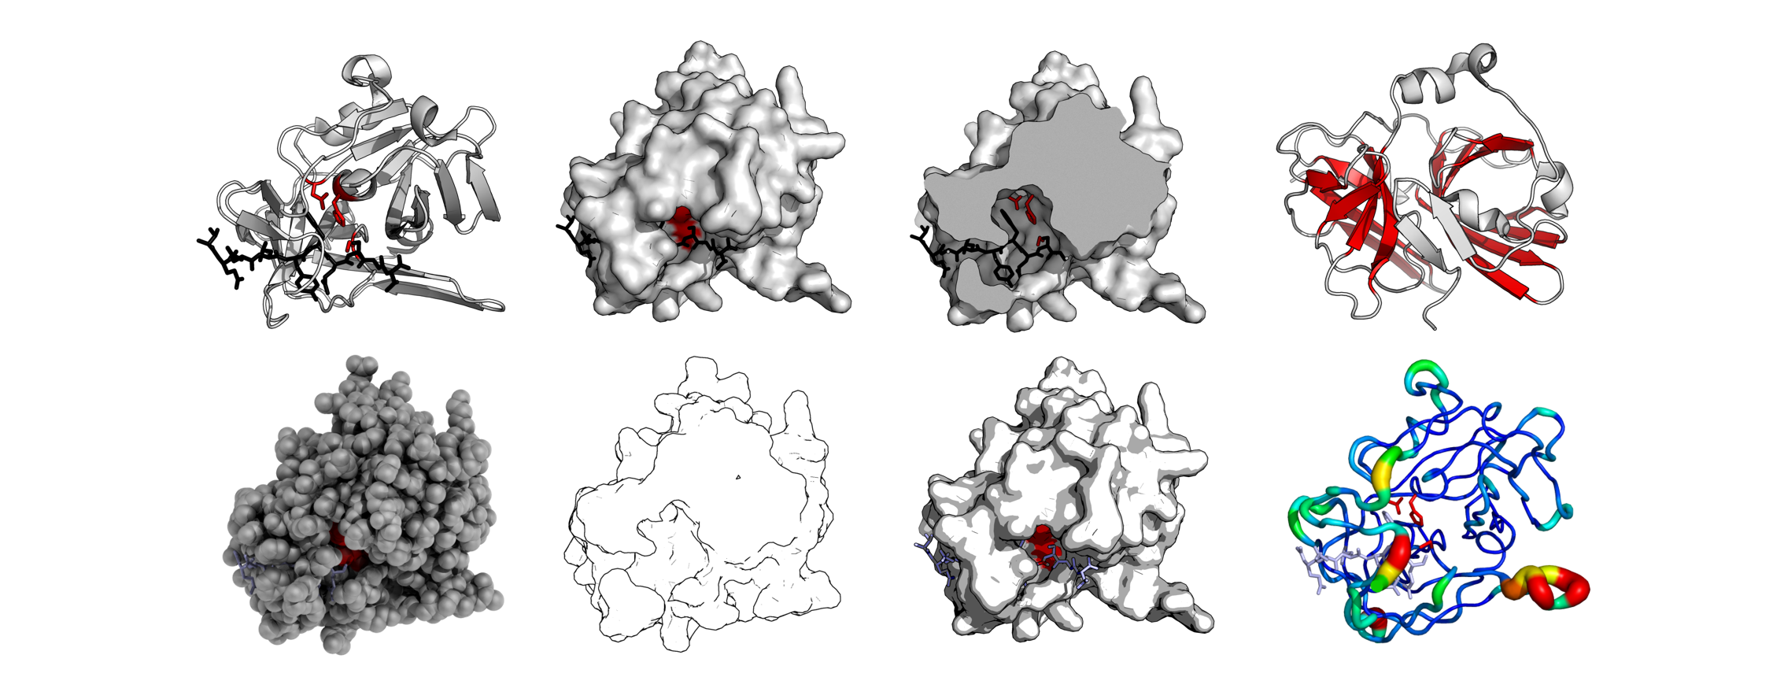
Same protein, different views

Slide 8



Molecular graphics systems
Jmol & JSmol - http://jmol.sourceforge.net/
PyMOL - http://www.pymol.org/
RasMol - http://www.rasmol.org/
UCSF Chimera - http://www.rbvi.ucsf.edu/chimera/
VMD - http://www.ks.uiuc.edu/Research/vmd
3Dmol.js - http://3dmol.csb.pitt.edu/

Slide 9
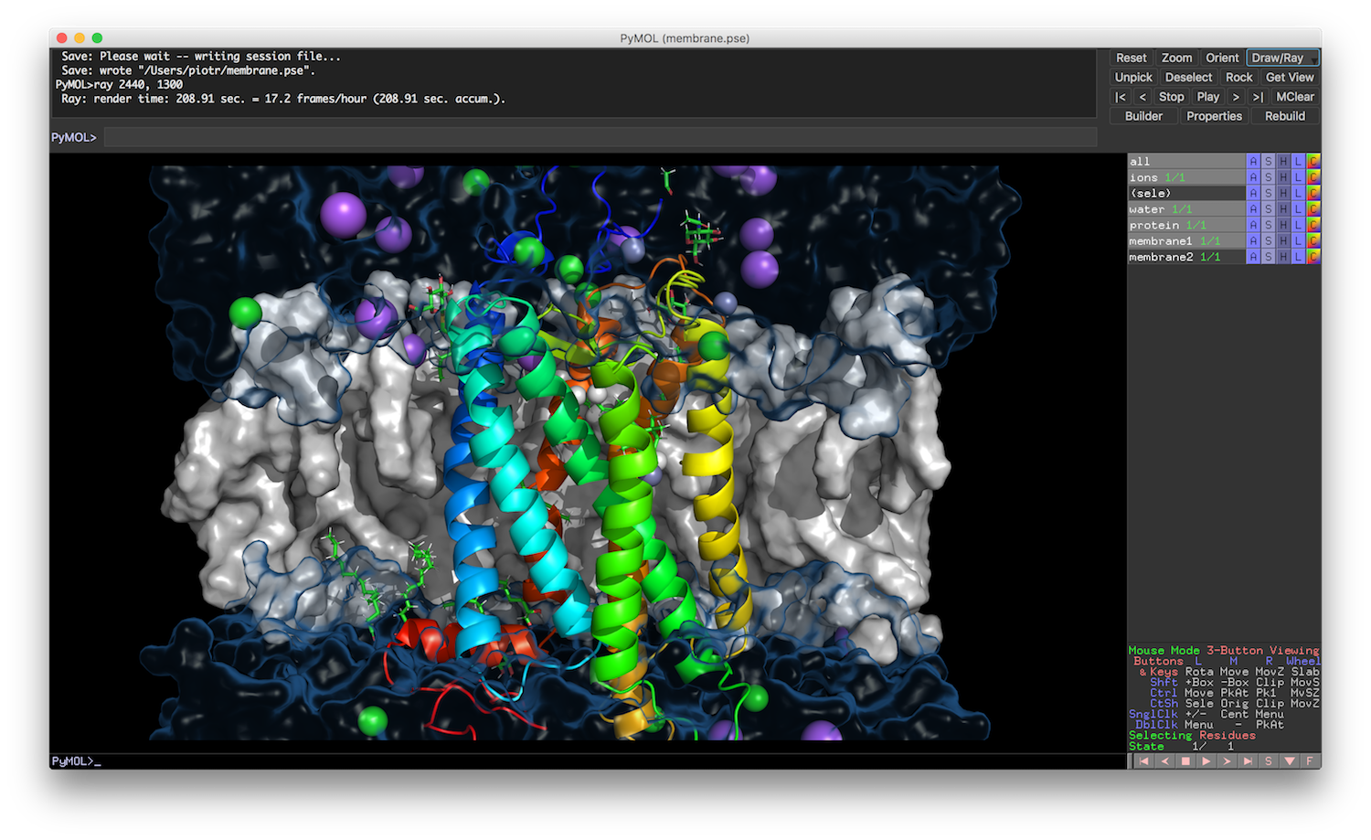

Slide 10
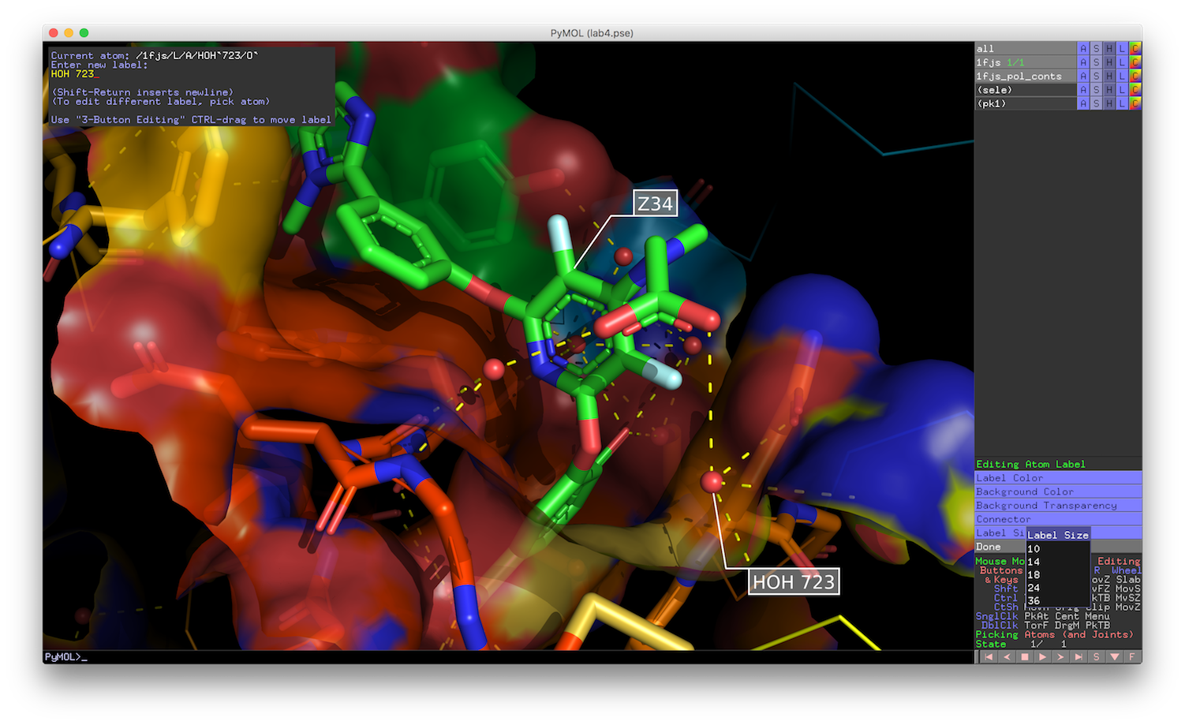

Slide 11
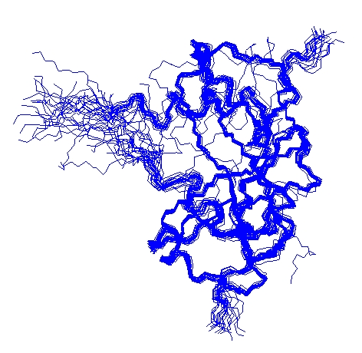
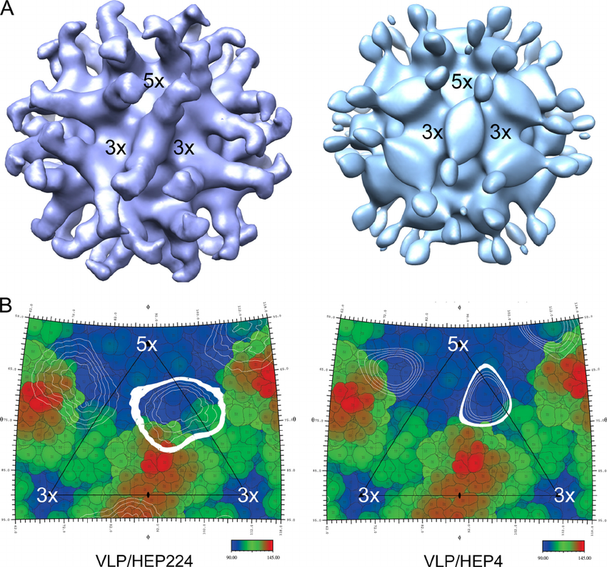
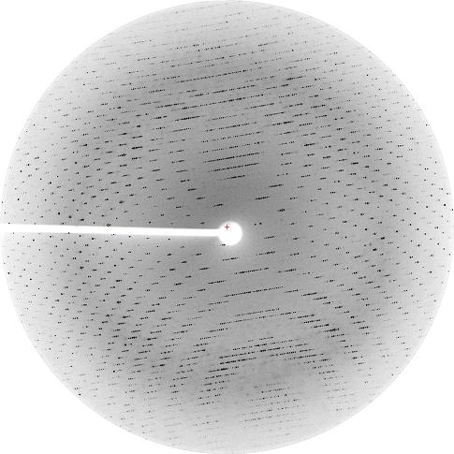
Experimental techniques for determining protein structure models
X-ray crystallography
Nuclear Magnetic Resonance (NMR)
Cryo-Electron Microscopy (Cryo-EM)
https://pdb101.rcsb.org/learn/guide-to-understanding-pdb-data/methods-for-determining-structure

Slide 12
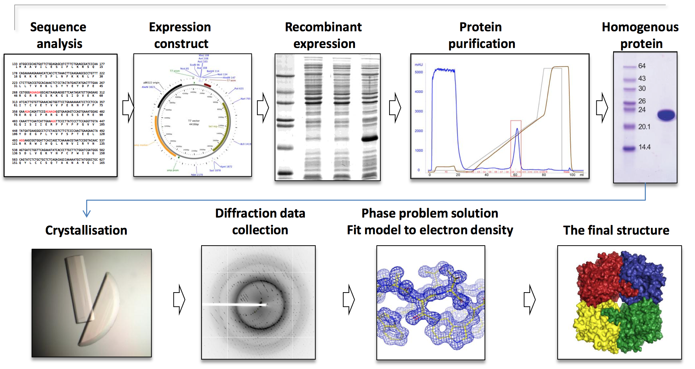
X-ray crystallography

Slide 13
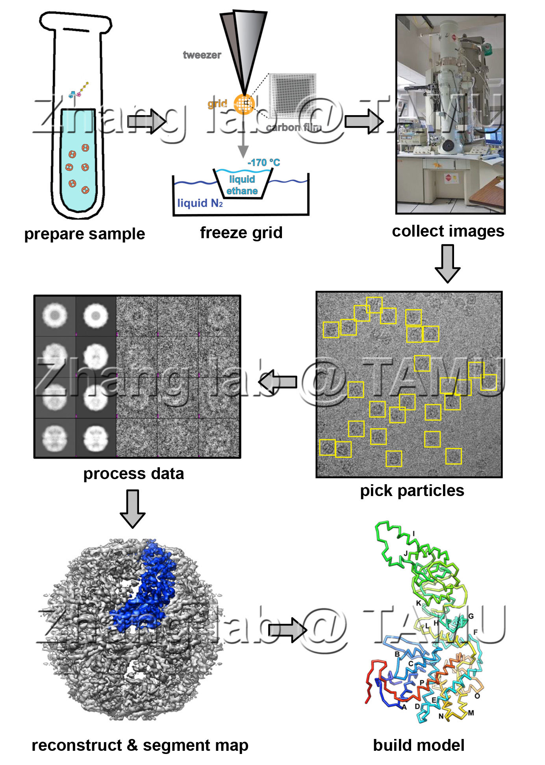
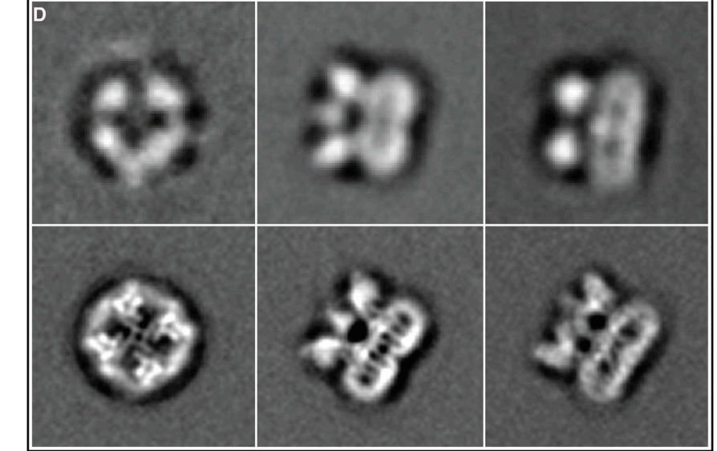
Cryo-EM
Can now do very high resolution
Less sample than X-ray
No need for crystals
Much faster
[doi:10.1016/j.tibs.2014.10.005]

Slide 14
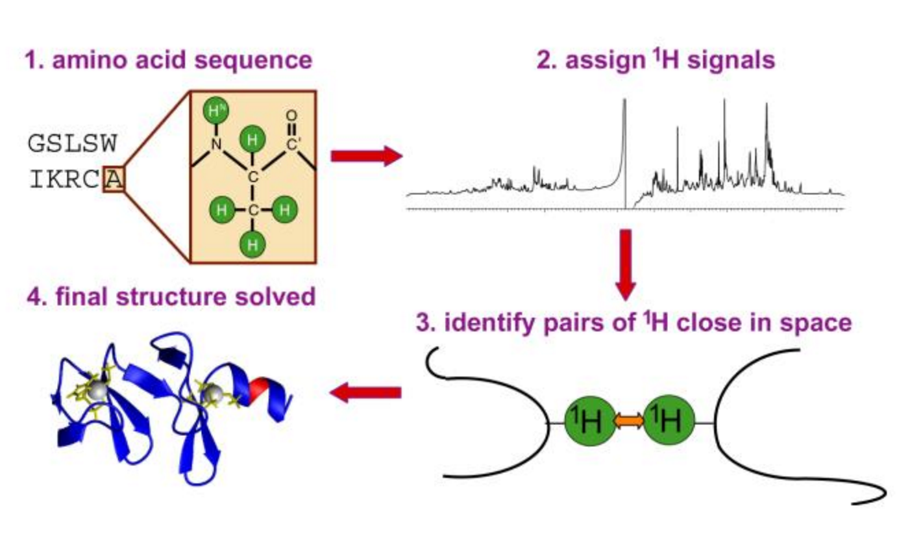
NMR

Slide 15
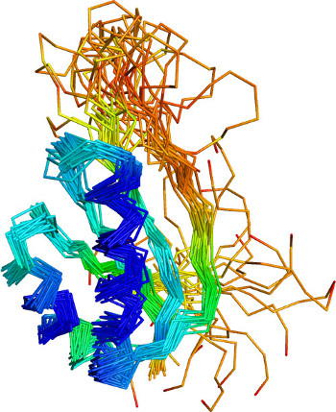
NMR
Ensemble of solutions to distance constraints
More rigid regions are more precisely determined
Useful in studying protein dynamics

Slide 16
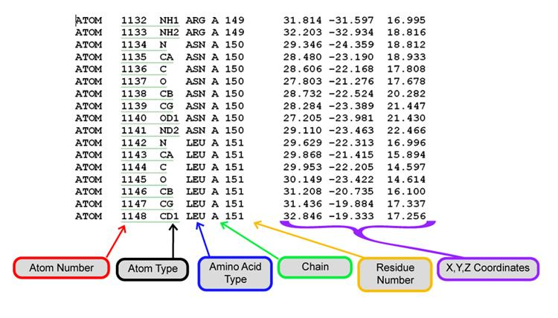
How do we store a structural model? PDB file format

Slide 17
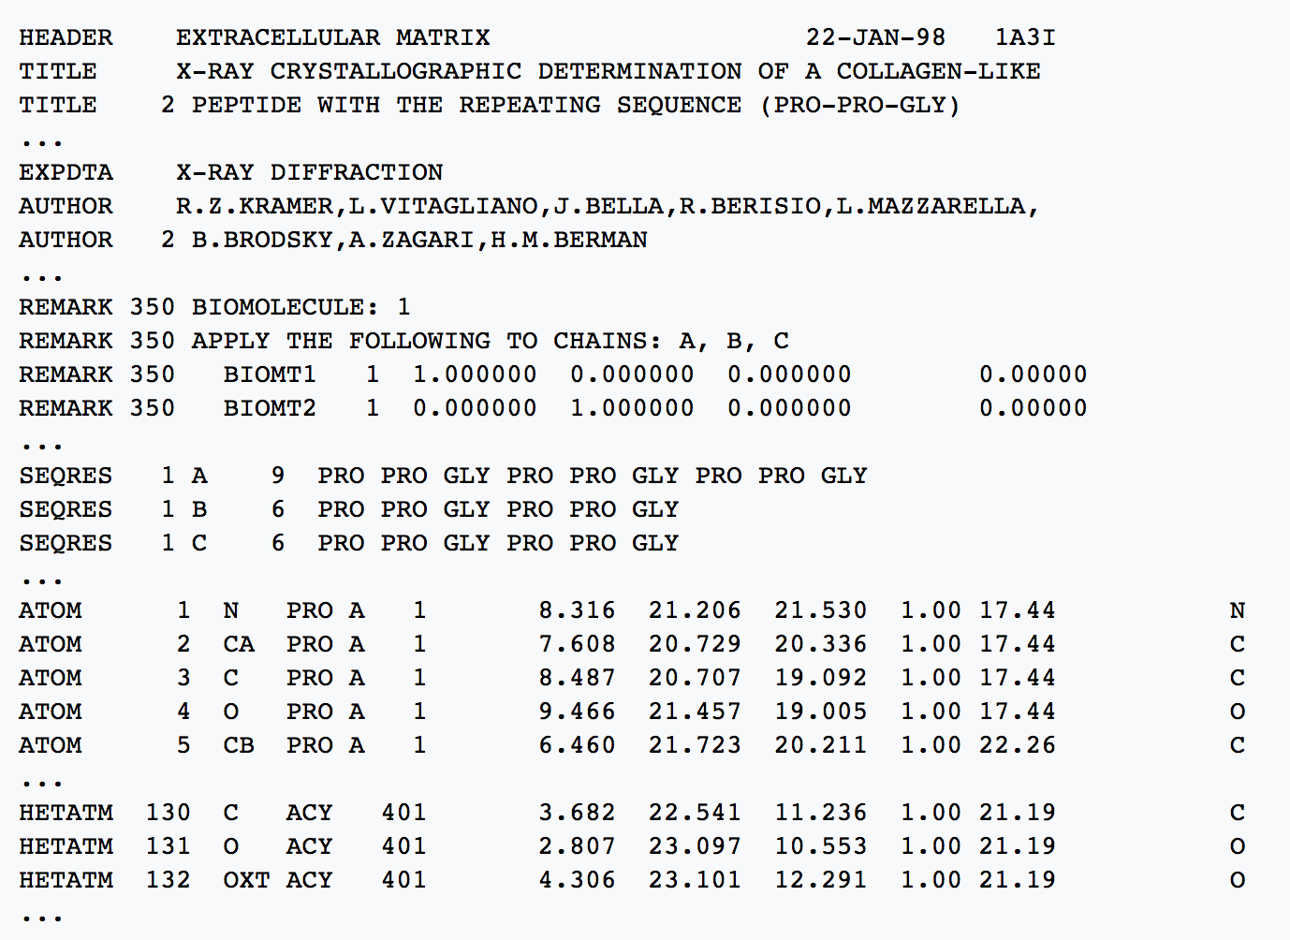
How do we store a structural model? PDB file format

Slide 18

Structural model databases
Protein Data Bank (PDB) - http://www.rcsb.org/ or http://www.ebi.ac.uk/pdbe/
Electron Microscopy Data Bank (EMDB) - https://www.ebi.ac.uk/pdbe/emdb/

Slide 19
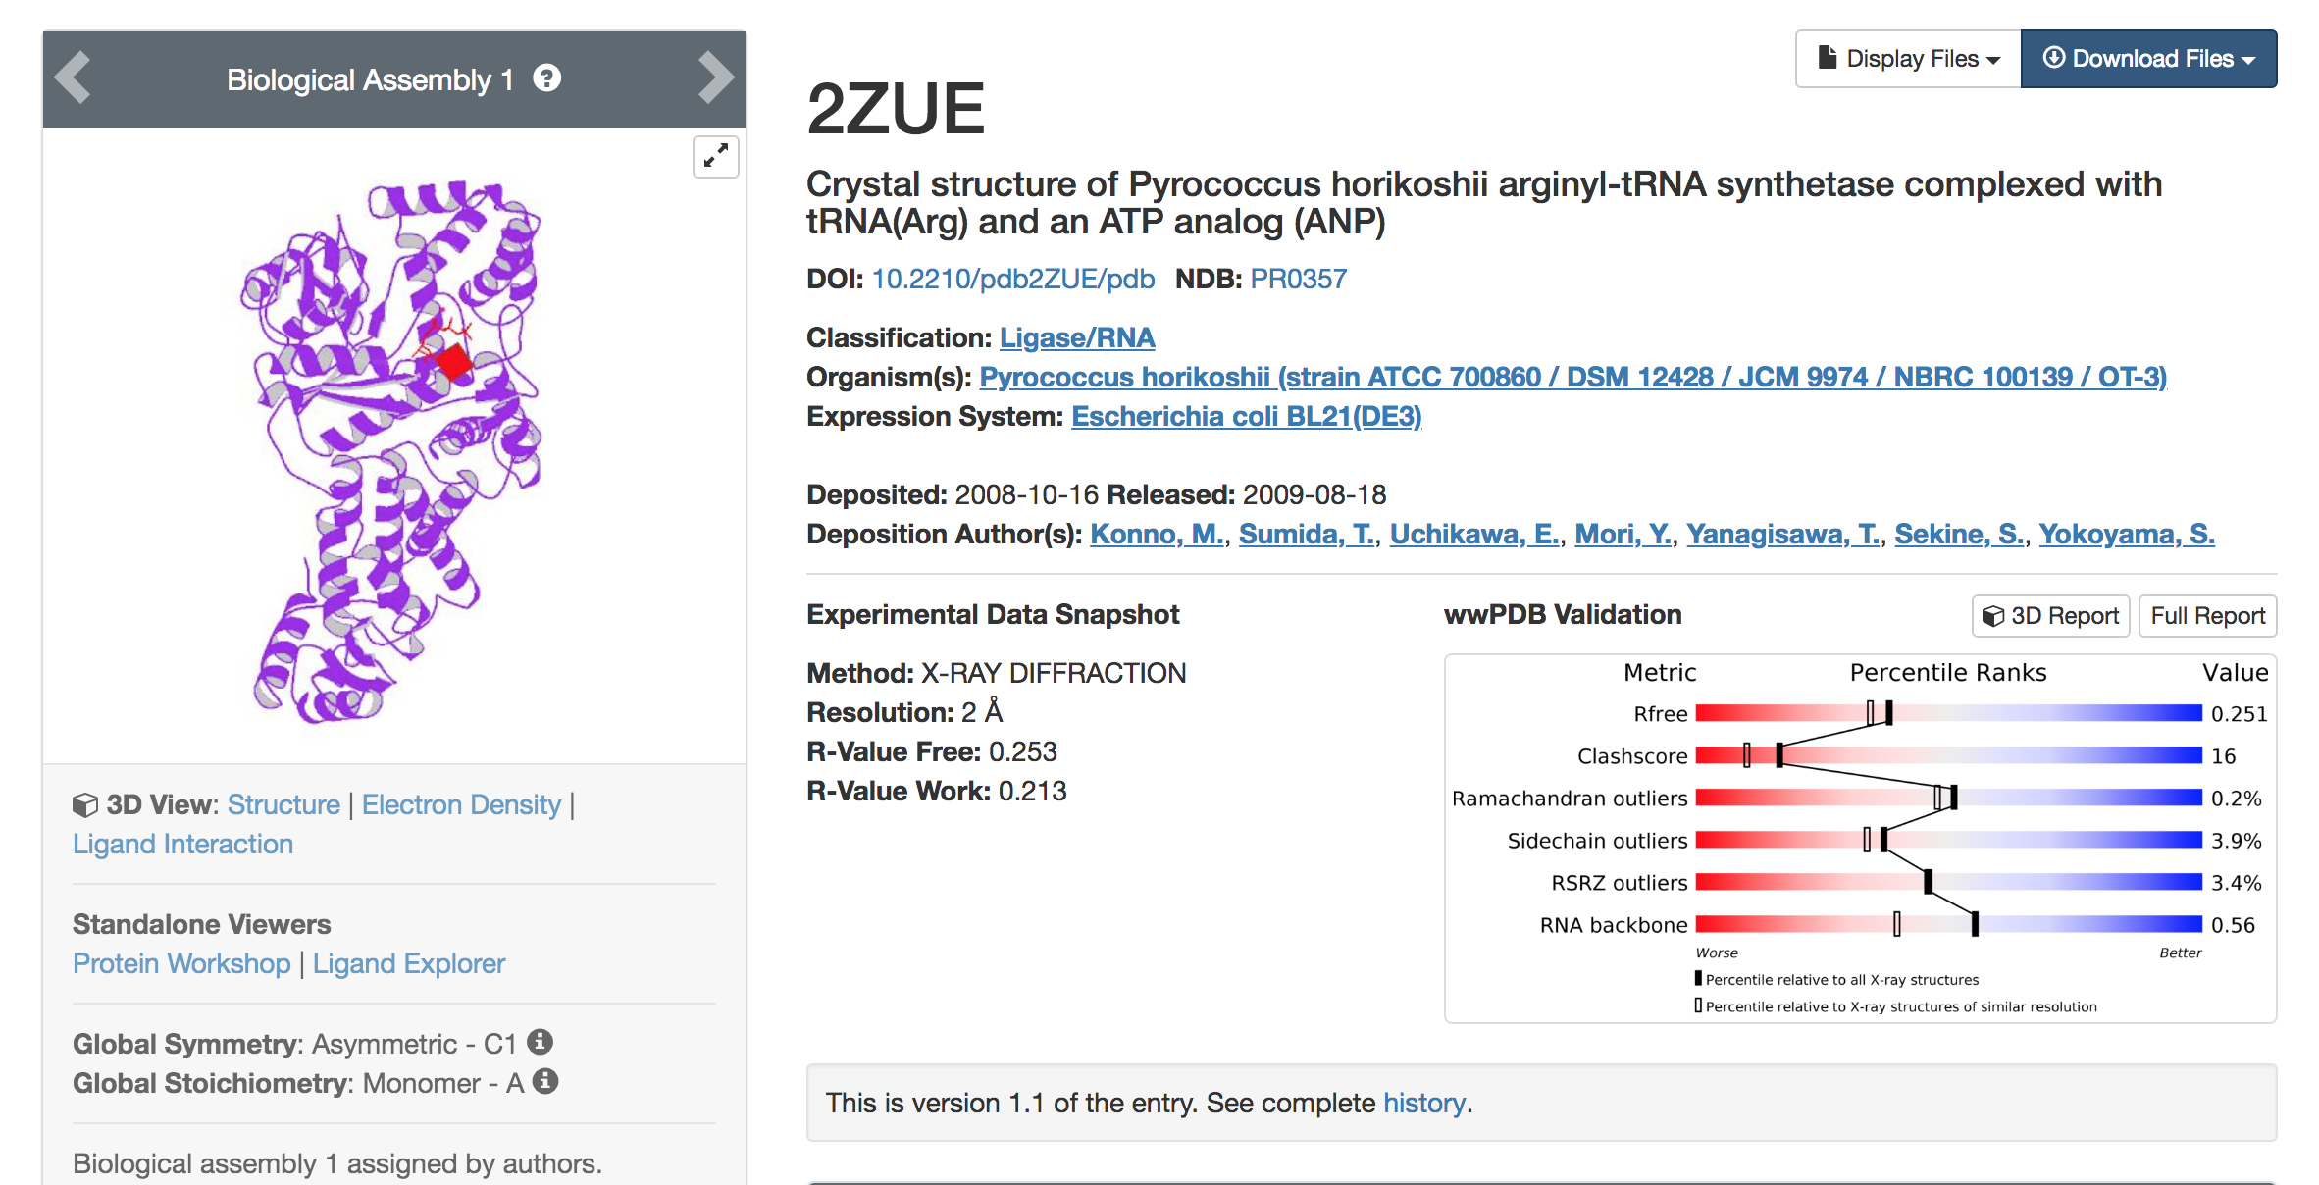

Slide 20
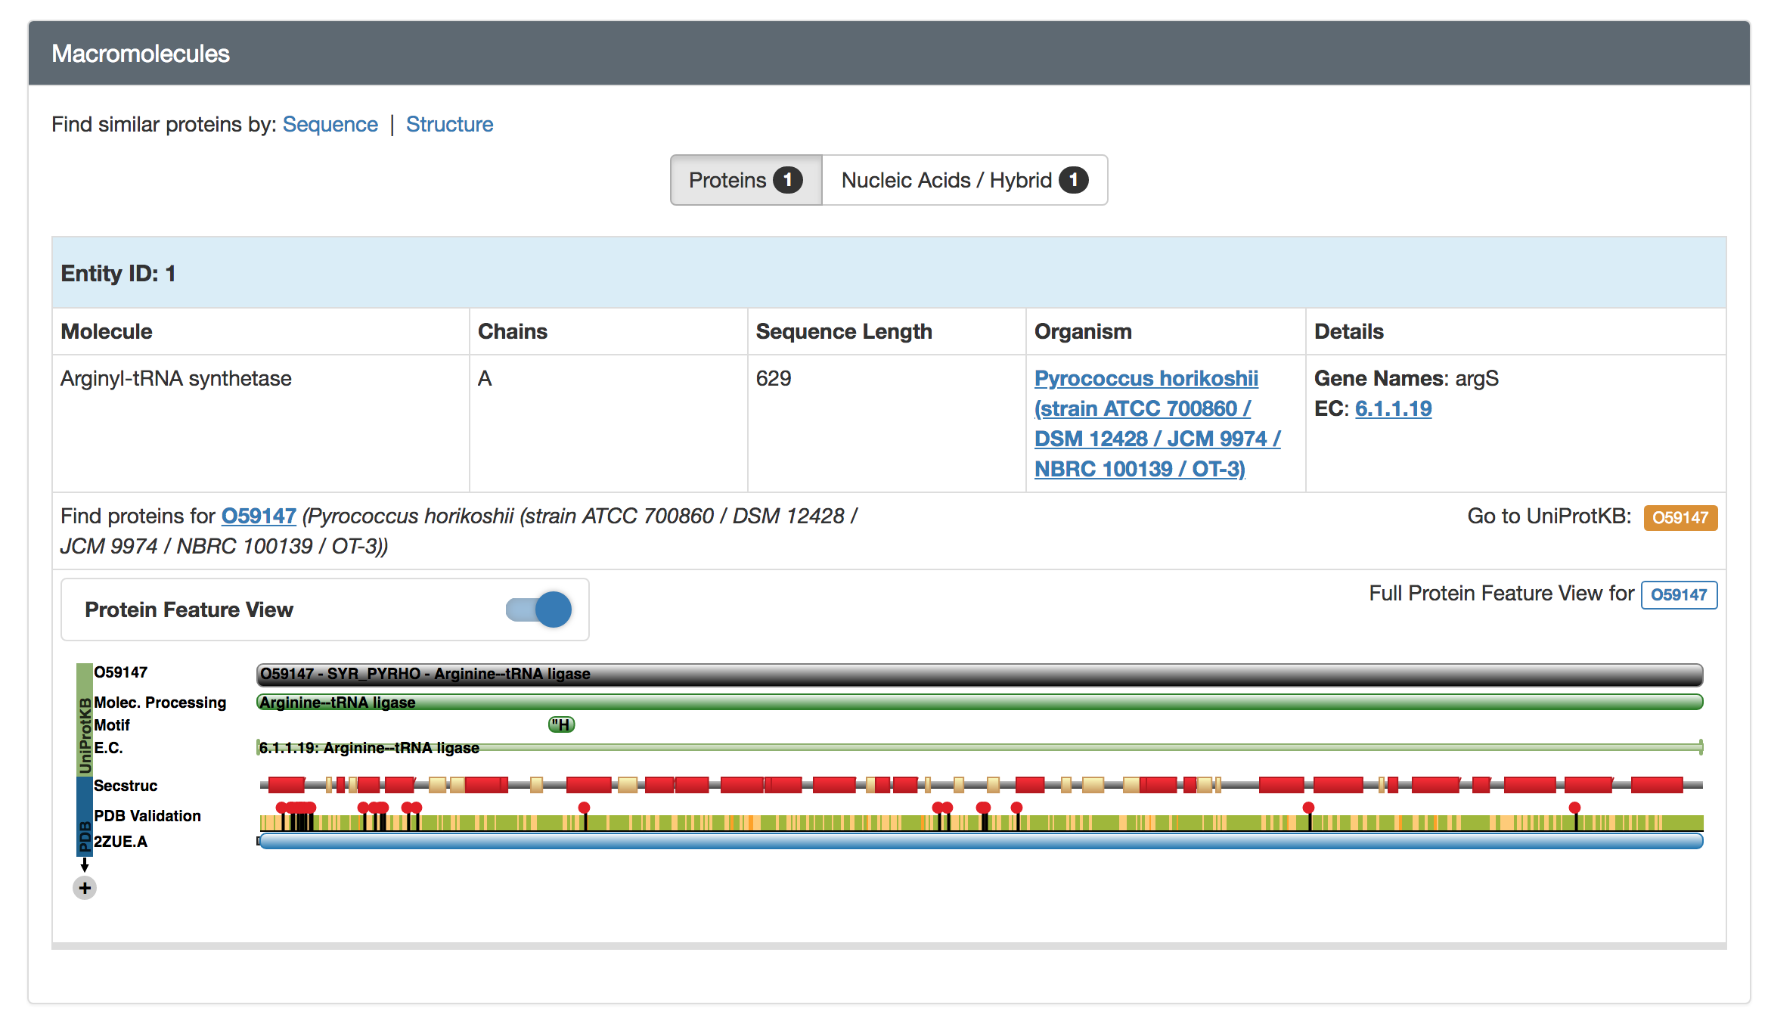

Slide 21
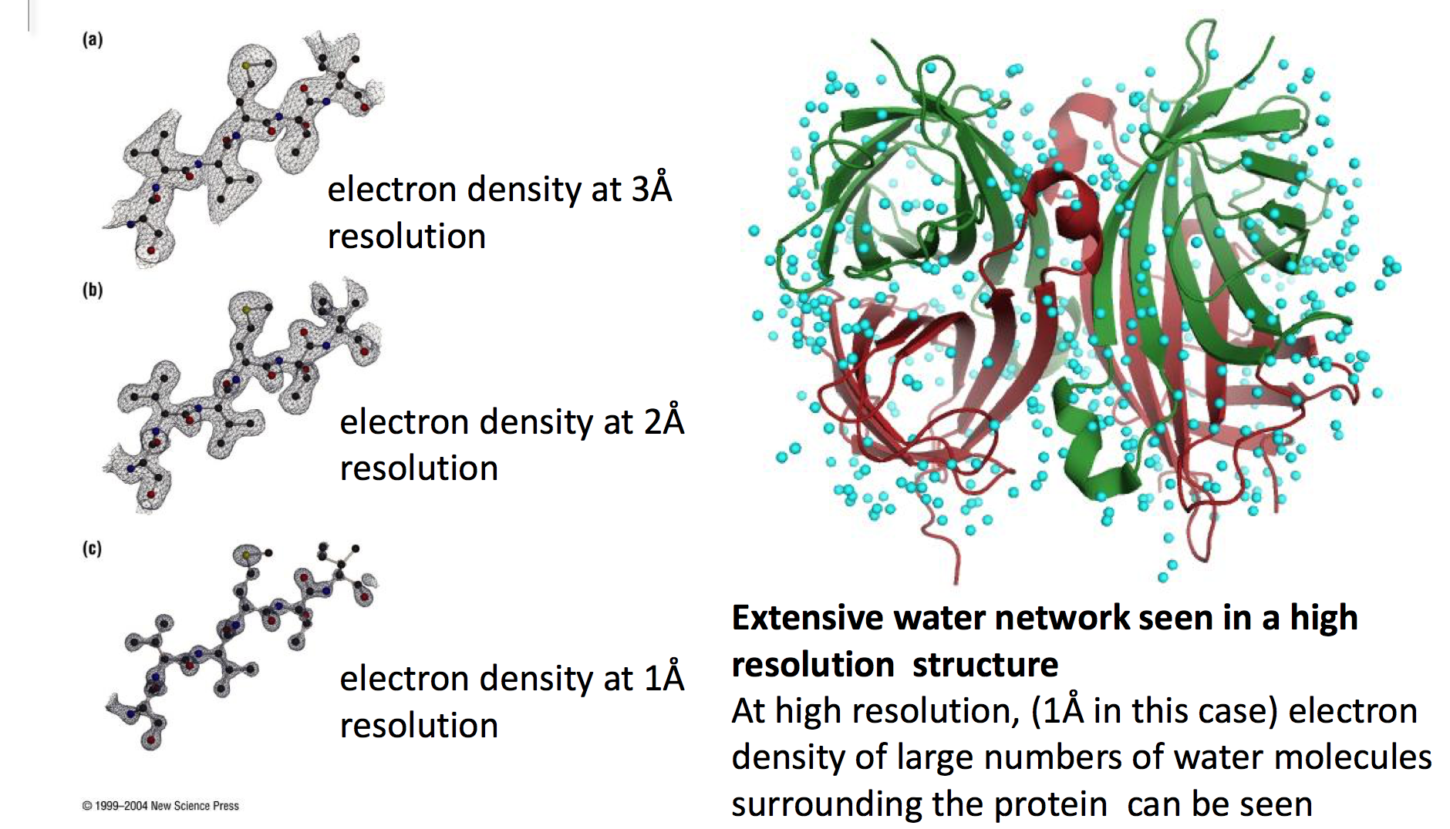
What is a good structural model?

Slide 22
What is a good structural model?
The quality of published molecular models is inversely related to the impacts of the journals in which they are published. [doi:10.3389/fnhum.2018.00037; doi:10.1107/S0907444907033847]
Missing residues and atoms – no electron density
Geometric and conformation validation criteria
Bond lengths, angles and planes
Protein backbone conformation (Ramachandran plot)
Protein sidechain conformations (rotamers)
All-atom contacts and clashes
Underpacking (holes in core)
Analyses available: PDBREPORTS, MolProbity, WHAT_IF

Slide 23
What is a good structural model?
Global quality – resolution
2.5 Å is good enough
Global quality – R value
a measure of error between the observed intensities from the diffraction pattern and the predicted intensities that are calculated from the model
a value of 0.20 or lower is considered good
not always reliable
Global quality – free R value
calculated in the same manner as the R value, but from a subset of the data set aside for the calculation of free R, and not used in the refinement of the model
cross validation – free of refinement bias
should not exceed (resolution/10) by more than 0.05
Local quality – temperature factor (B value)
uncertainty in the positions of atoms increases with disorder in the protein crystal
high temperature factor reflects a low empirical electron density for the atom
a value of less than 30 Å² signifies confidence in the position of a residue

Slide 24
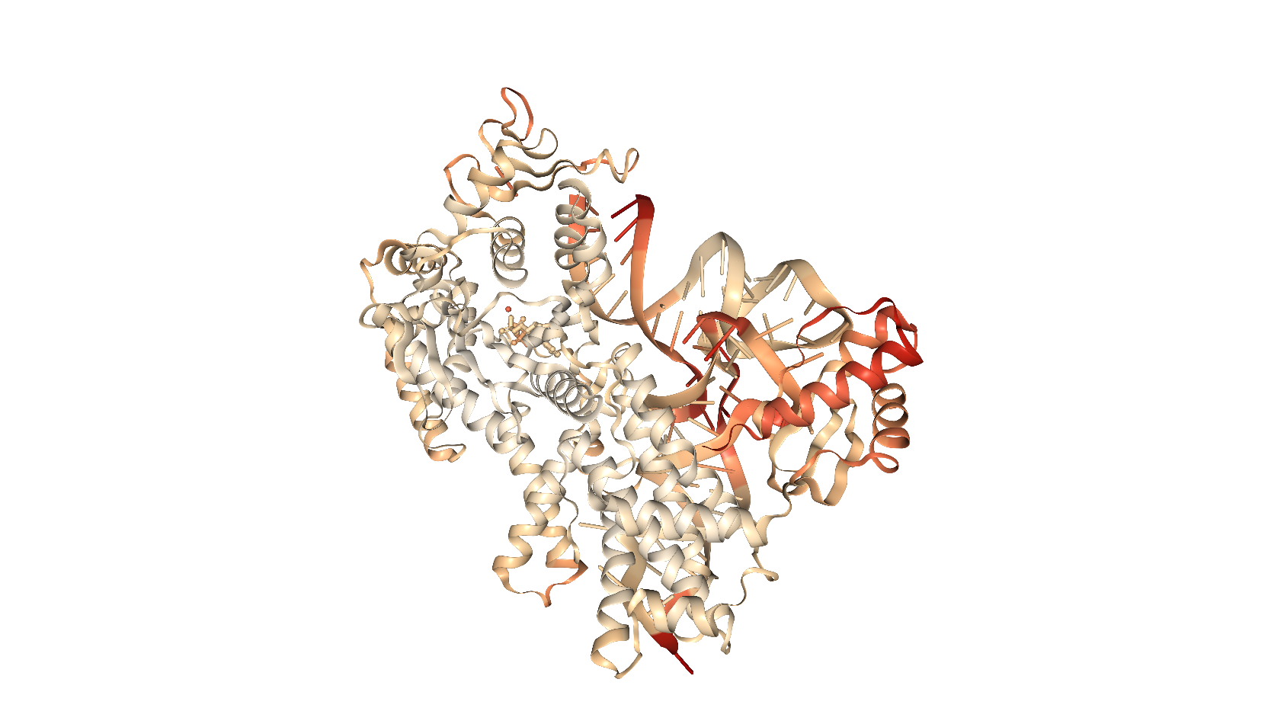
2ZUE coloured by B factor

Slide 25
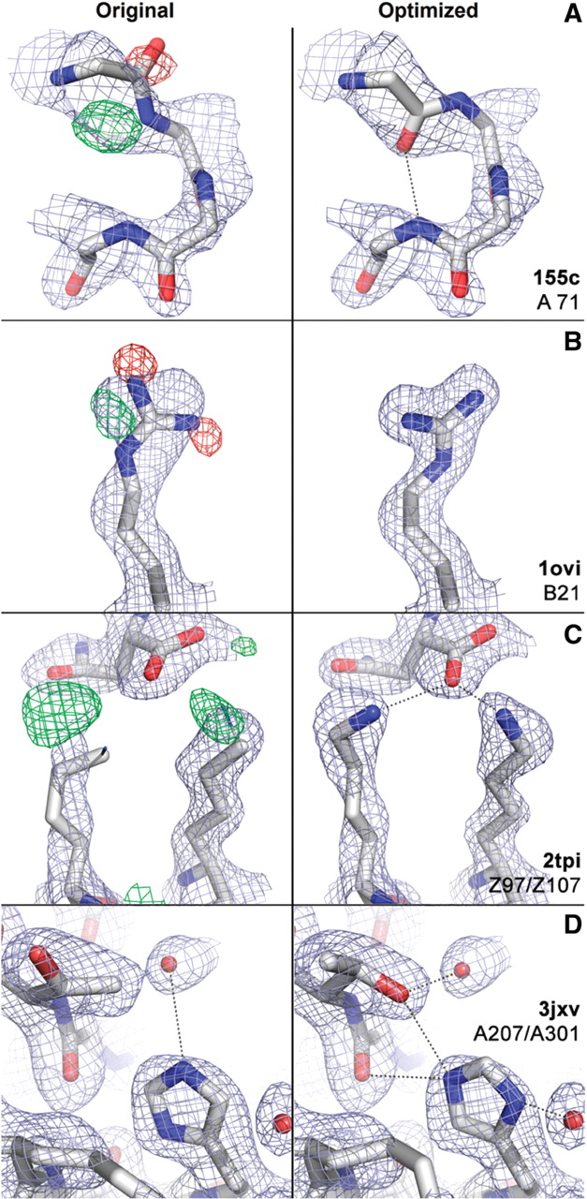
PDB-REDO
Optimised structures
Refinement, rebuilding and validation
Typically, these are better quality structures and should be used instead of originals!
The method introduces consistency – better for large scale analyses
https://pdb-redo.eu

Slide 26
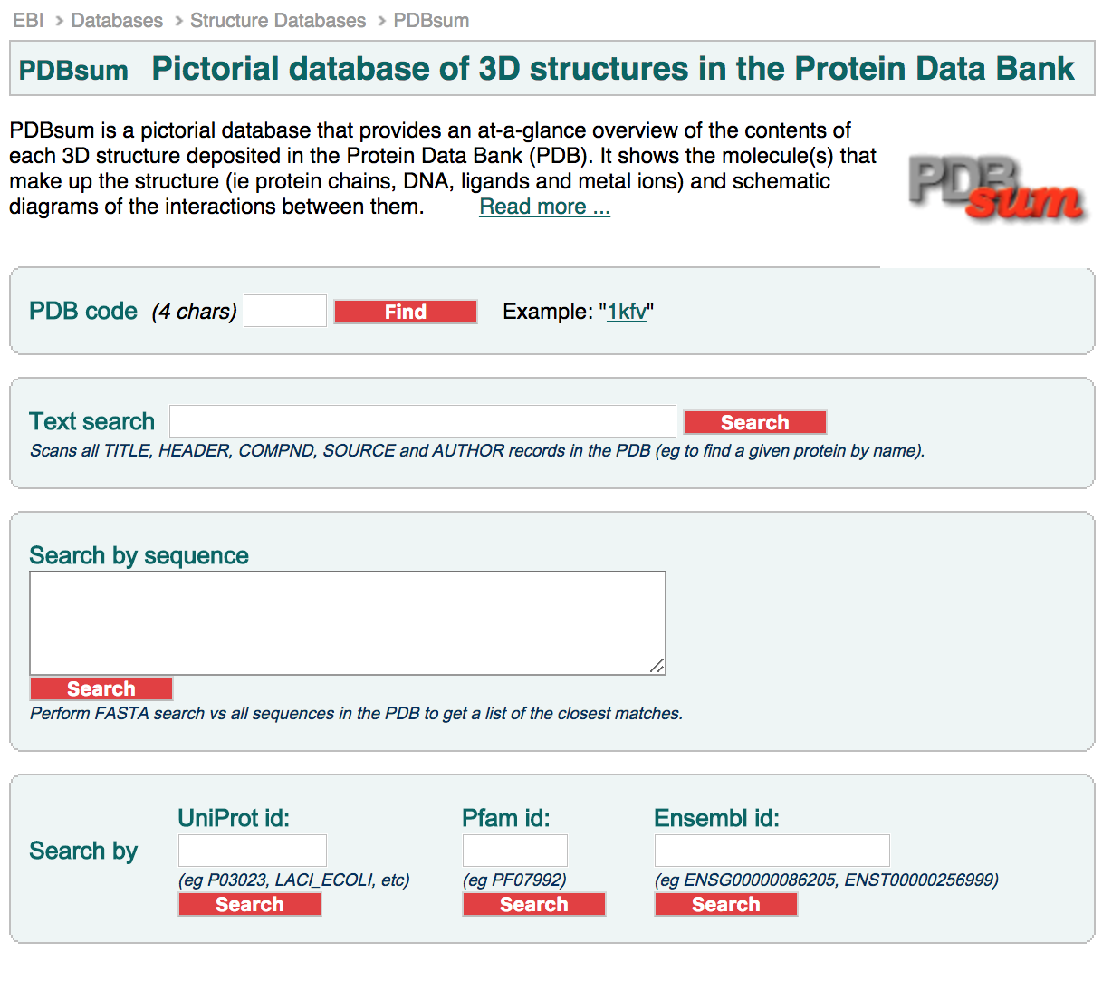
What can we learn from the structural model? Atlases
PDBsum - http://www.ebi.ac.uk/pdbsum/

Slide 27
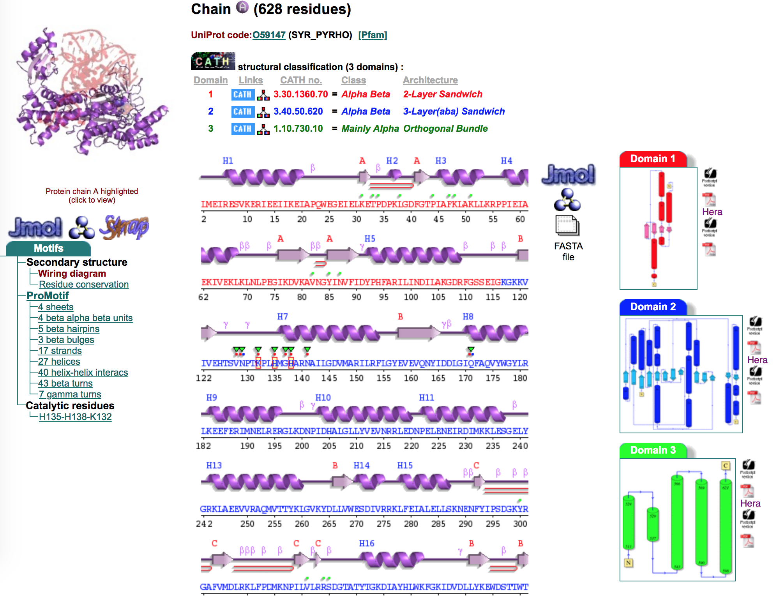

Slide 28
What can we learn from the structural model? Classification
Structural Classification of Proteins (SCOP)
SCOP2 (recently released): http://scop2.mrc-lmb.cam.ac.uk/
SCOPe/ASTRAL (extension of v1, most used): http://scop.berkeley.edu/
Hierarchical classification levels:
Class: type of fold (see next slide)
Fold: major structural similarity
Superfamily: probable common evolutionary origin
Family: clear evolutionary relationship
Protein domain: same protein unit
Species

Slide 29
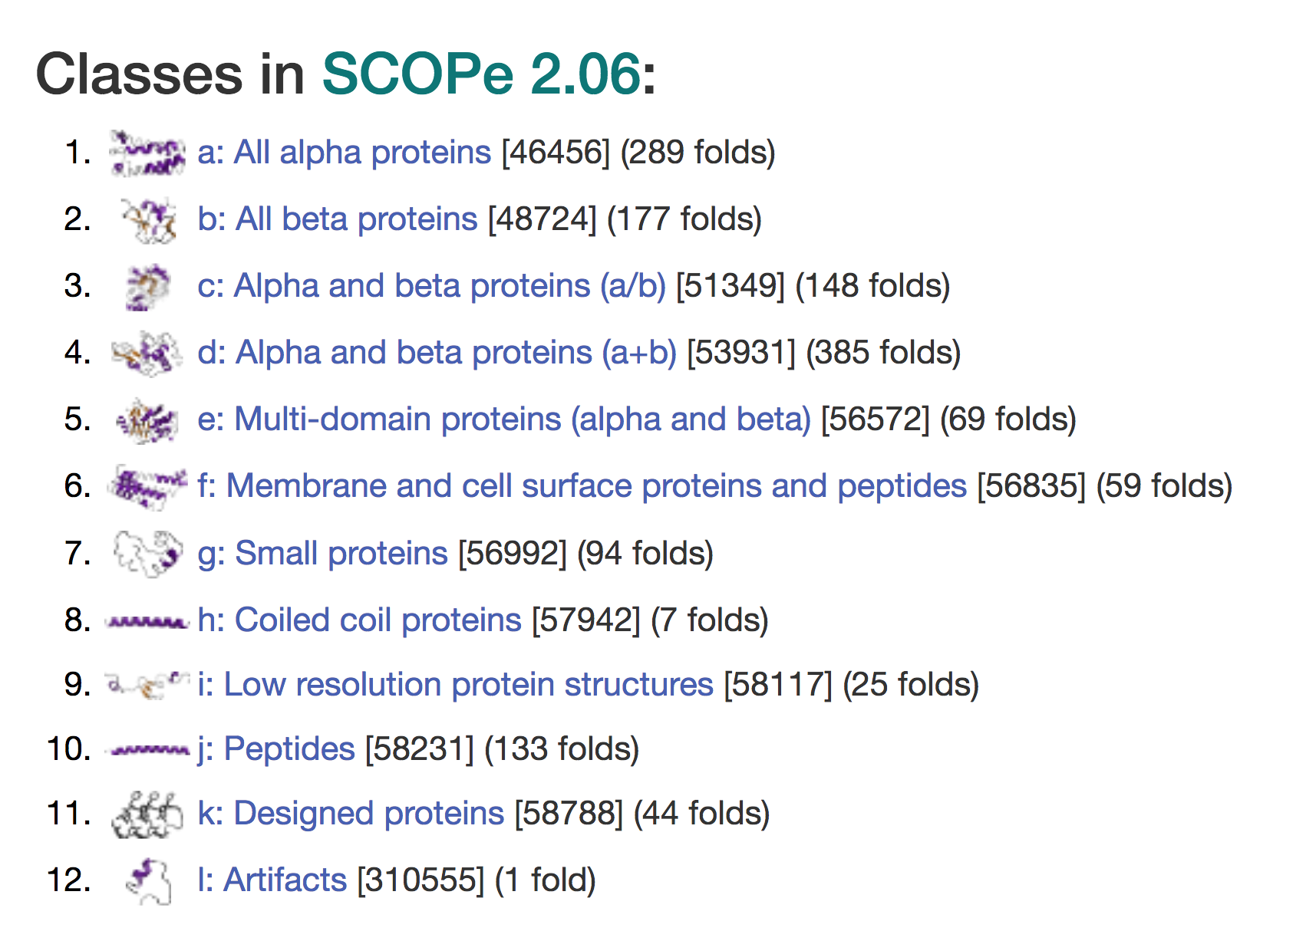

Slide 30
What can we learn from the structural model? Classification
Structural Classification of Proteins (SCOP)
Pfam - http://pfam.xfam.org/
large collection of protein families, each represented by multiple sequence alignments and hidden Markov models (HMMs)
SUPERFAMILY - http://supfam.org/
database of structural and functional annotation for all proteins and genomes
CATH - http://cathdb.info/
evolutionary relationships of protein domains

Slide 31
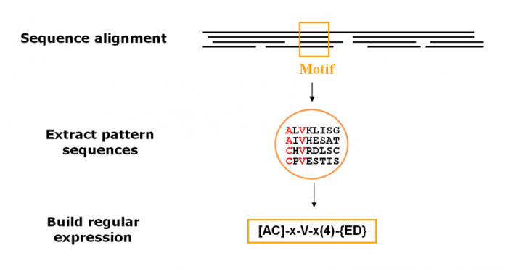
Classification is based on protein signatures
Patterns - important sequence features, such as binding sites or the active sites of enzymes, consist of only a few amino acids that are essential for protein function (e.g. PROSITE)

Slide 32
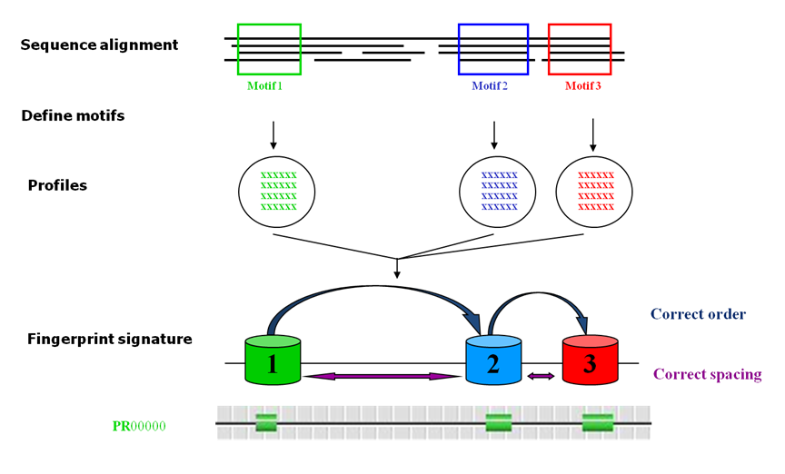
Classification is based on protein signatures
Fingerprints – consist of multiple short conserved motifs, which are drawn from sequence alignments (e.g. PRINTS)

Slide 33
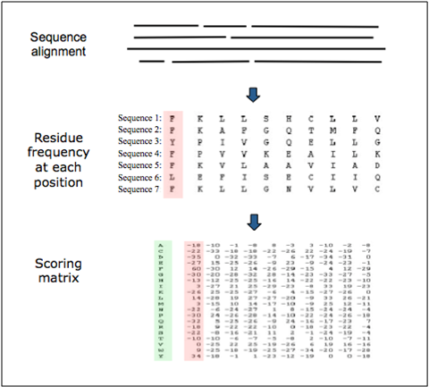
Classification is based on protein signatures
Profiles
built by converting multiple sequence alignments into position-specific scoring matrices (PSSMs)
amino acids at each position in the alignment are scored according to the frequency with which they occur
substitution matrices (e.g. BLOSUM) can be used to add evolutionary distance weighting to these scores.
E.g. HAMAP, PROSITE

Slide 34
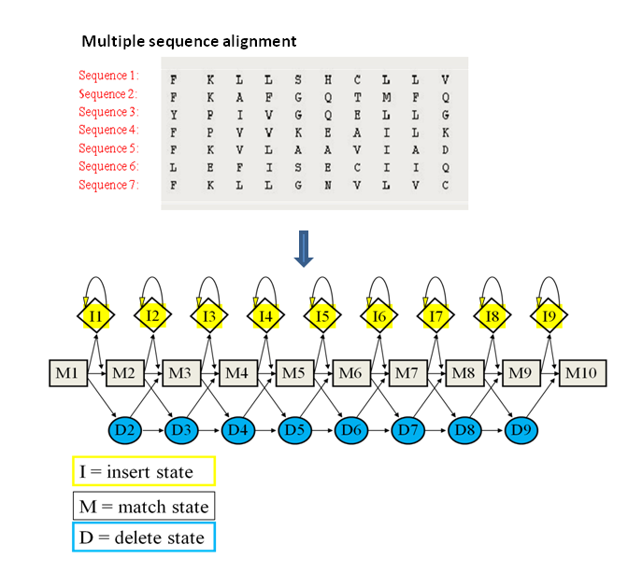
Classification is based on protein signatures
Hidden Markov Models (HMMs)
similar to profiles, but more sophisticated and powerful statistical models
very well suited to searching databases for homologous sequences
e.g. Pfam, PANTHER

Slide 35
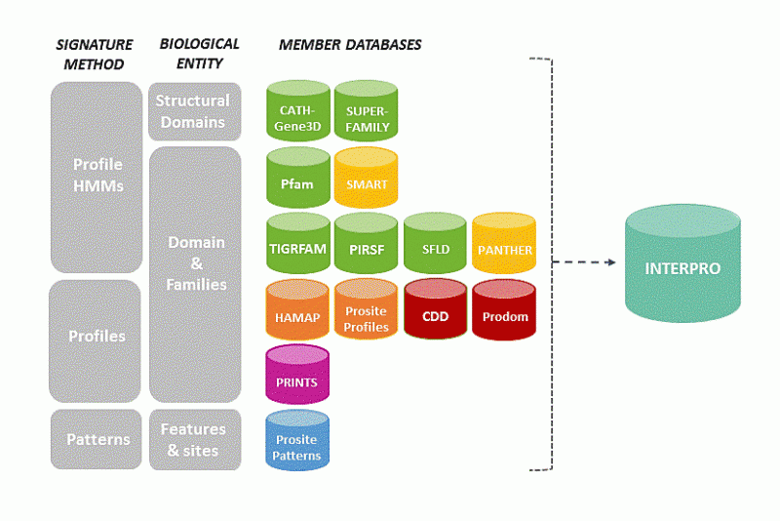
Integrating resources
InterPro - https://www.ebi.ac.uk/interpro/
a resource that provides functional analysis of protein sequences by classifying them into families and predicting the presence of domains and important sites
uses predictive models, known as signatures, provided by several different databases
list of consortium members: https://www.ebi.ac.uk/interpro/about.html

Slide 36
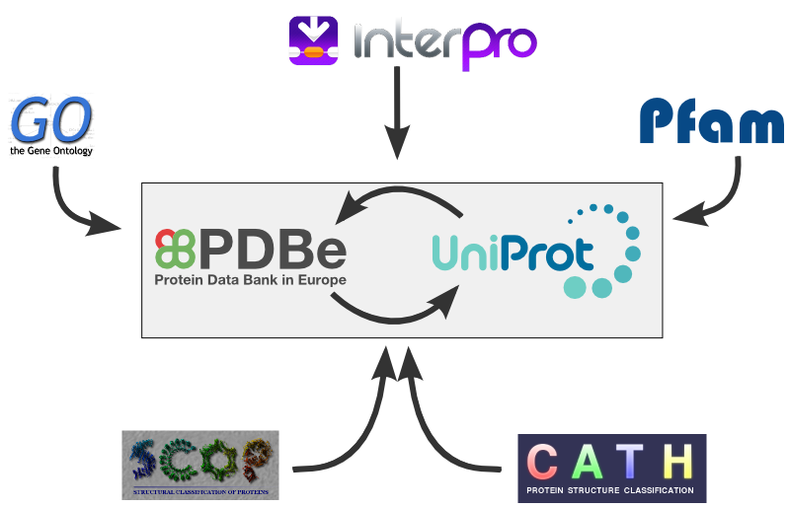
Integrating resources
Structure Integration with Function, Taxonomy and Sequence (SIFTS) - https://www.ebi.ac.uk/pdbe/docs/sifts/index.html

Slide 37
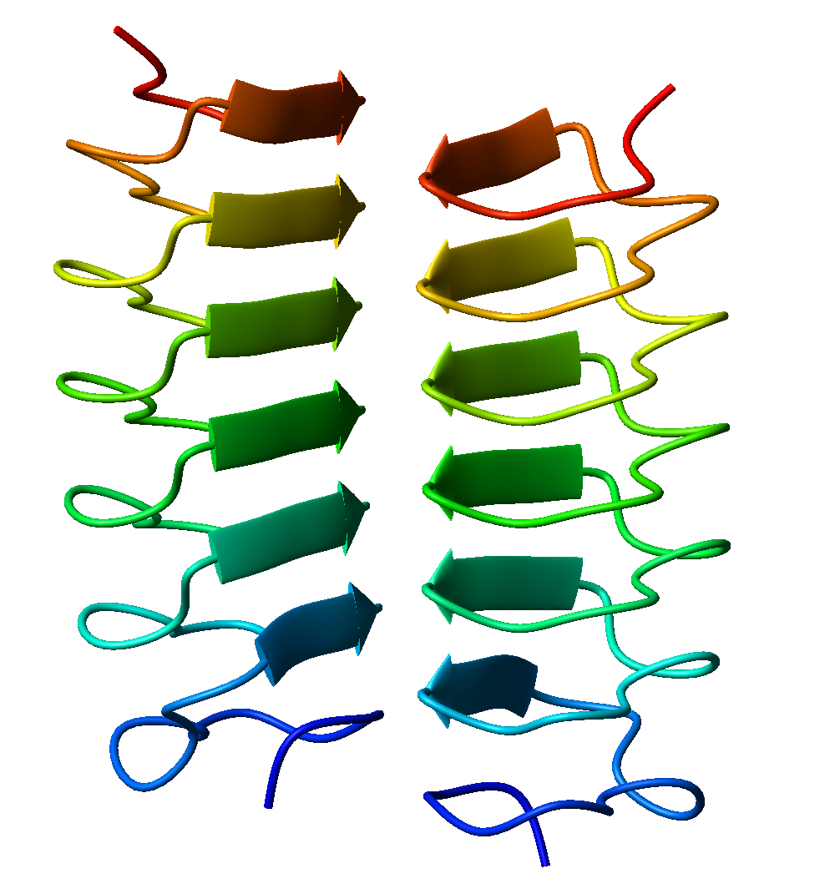
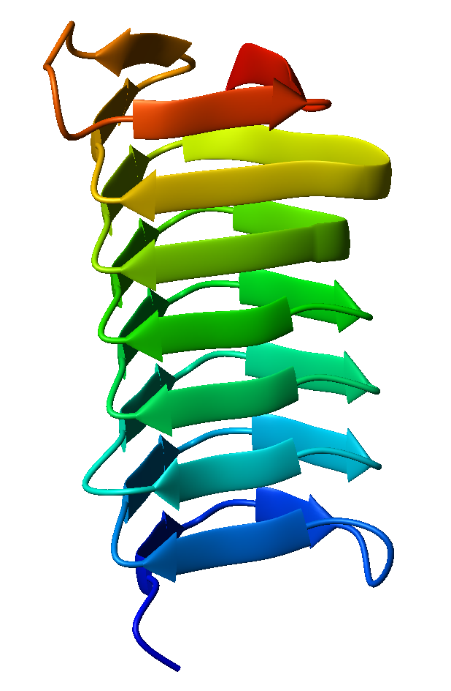
Intermission! BETA helices
1EZG
1M8N

Slide 38
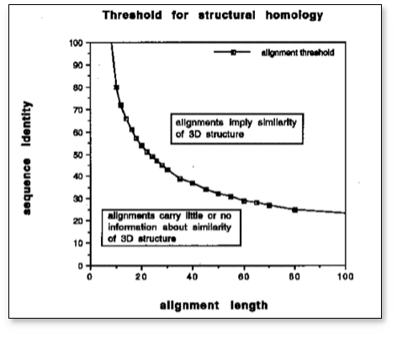
Structure is more conserved than sequence

Slide 39
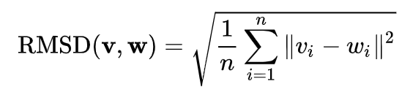
Structural alignment
a way to establish homology between proteins based on their structure
3D analogue of sequence alignment
valuable tool for the comparison of proteins with low sequence similarity, where evolutionary relationships between proteins cannot be easily detected by standard sequence alignment techniques
tools: MUSTANG, MATT, FUGUE, MAMMOTH
databases: DALI, HOMSTRAD
output: superposition of the atomic coordinate sets and a minimal root mean square deviation (RMSD) between the structures

Slide 40
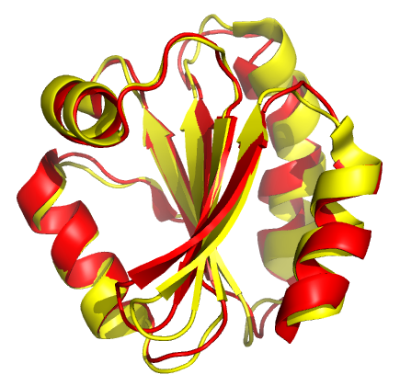
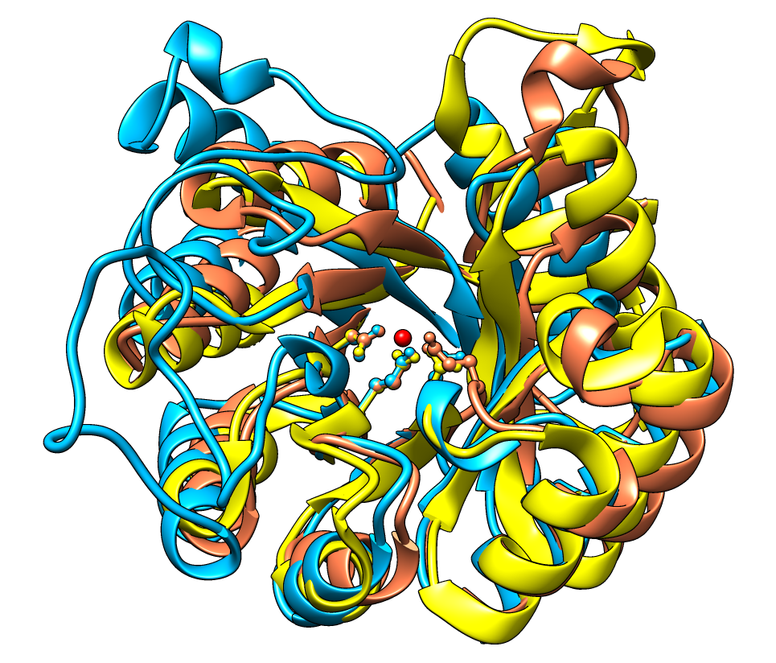

Slide 41
What if I don’t have a structure?
Comparison to known proteins/domains based on sequence similarity and signatures
Homology modelling

Slide 42
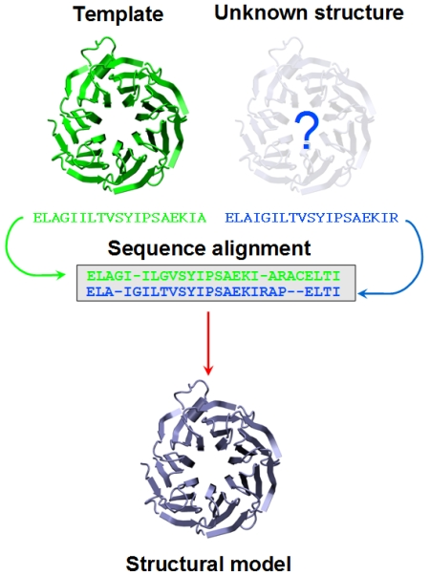
Homology modelling

Slide 43
Homology modelling
Select a template structure – needs to share at least 30% sequence similarity with your protein, preferably 50%
Align the sequences
Generate geometric criteria and “fit” the new sequence into the structure
Assess the model according to statistical potentials or physics-based energy calculations
Accuracy highly dependent on sequence identity between target and template
SWISS-MODEL - https://swissmodel.expasy.org/

Slide 44
What if I don’t have a structure?
Predictions based on sequence
Secondary structure
PSIPRED - http://bioinf.cs.ucl.ac.uk/psipred/
JPred - http://www.compbio.dundee.ac.uk/jpred/
Disorder prediction
DISOPRED3 - http://bioinf.cs.ucl.ac.uk/psipred/
IUPRED – https://iupred2a.elte.hu/

Slide 45
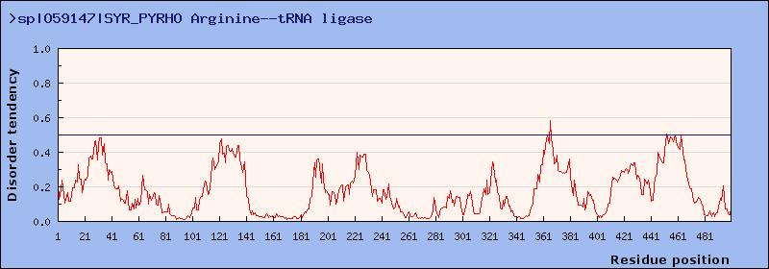
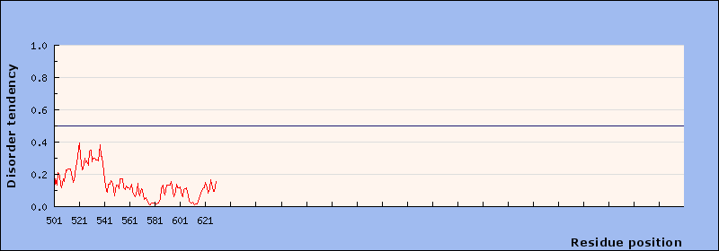

Slide 46
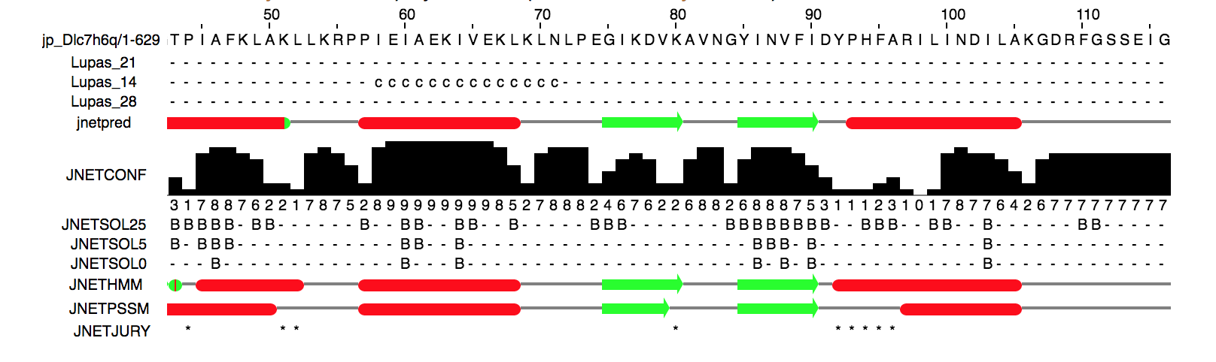

Slide 47
What can I do with a structure?
Evolutionary analysis
Homology modelling of related proteins
Analysis and prediction of interactions
Prediction of function
Prediction of disease phenotypes
Drug design
Protein engineering
Molecular dynamics simulations

Slide 48
What can I do with a structure? Interactions
PISA (Proteins, Interfaces, Structures and Assemblies) - http://www.ebi.ac.uk/pdbe/pisa/
analyses interfaces occurring in asymmetric units and also predicts probable quaternary structures based on interactions occurring in the macromolecular crystal
InterProSurf - http://curie.utmb.edu/prosurf.html
find interface residues in protein complex structures
HADDOCK (High Ambiguity Driven protein-protein DOCKing) - http://milou.science.uu.nl/services/HADDOCK2.2/haddock.php
information-driven flexible docking approach for the modelling of biomolecular complexes

Slide 49
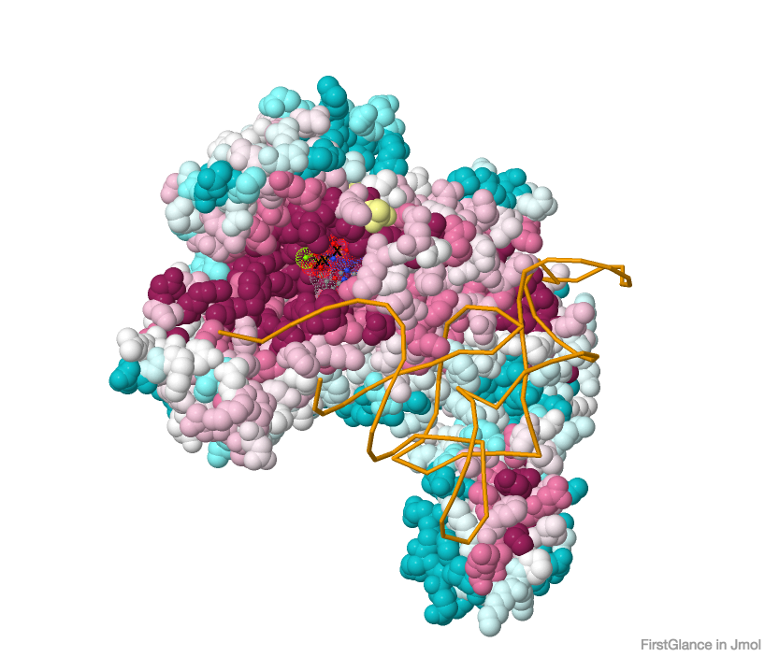
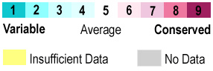
What can I do with a structure? Function
ConSurf & ConSurf-DB
http://consurf.tau.ac.il/ and http://consurfdb.tau.ac.il/
Function based on evolutionary conservation - looking for evolutionarily conserved patches of amino acids in a 3D protein structure is a good way to locate functional sites

Slide 50
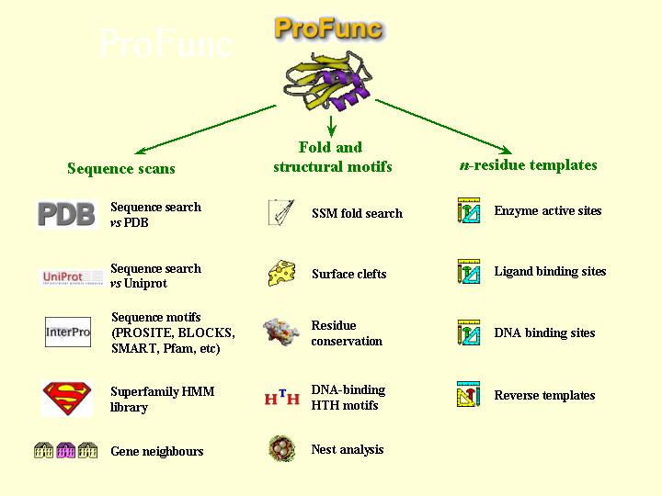
What can I do with a structure? Function
ProFunc - https://www.ebi.ac.uk/thornton-srv/databases/profunc/
prediction of protein function from 3D structure
uses a series of methods, including fold matching, residue conservation, surface cleft analysis, and functional 3D templates, to identify both the protein's likely active site and possible homologues in the PDB

Slide 51
What can I do with a structure? Disease phenotypes
SAAPdap - http://www.bioinf.org.uk/saap/dap/
likely structural effects of a mutation
Ensembl Variant Effect Predictor (VEP) - https://www.ensembl.org/info/docs/tools/vep/index.html

Slide 52

Machine Learning is changing everything…
…but we won’t go there today as it is still a wild wild west…

Slide 53
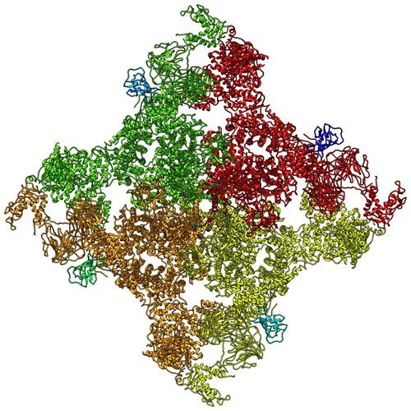
Intermission! Largest structure
5TA3 - 39,852 amino acids
RYR1 by Cryo-EM at 4.4 Å

Slide 54
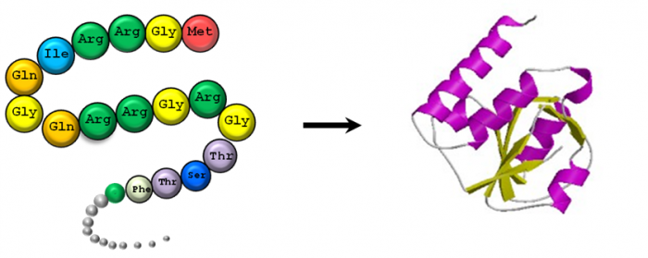
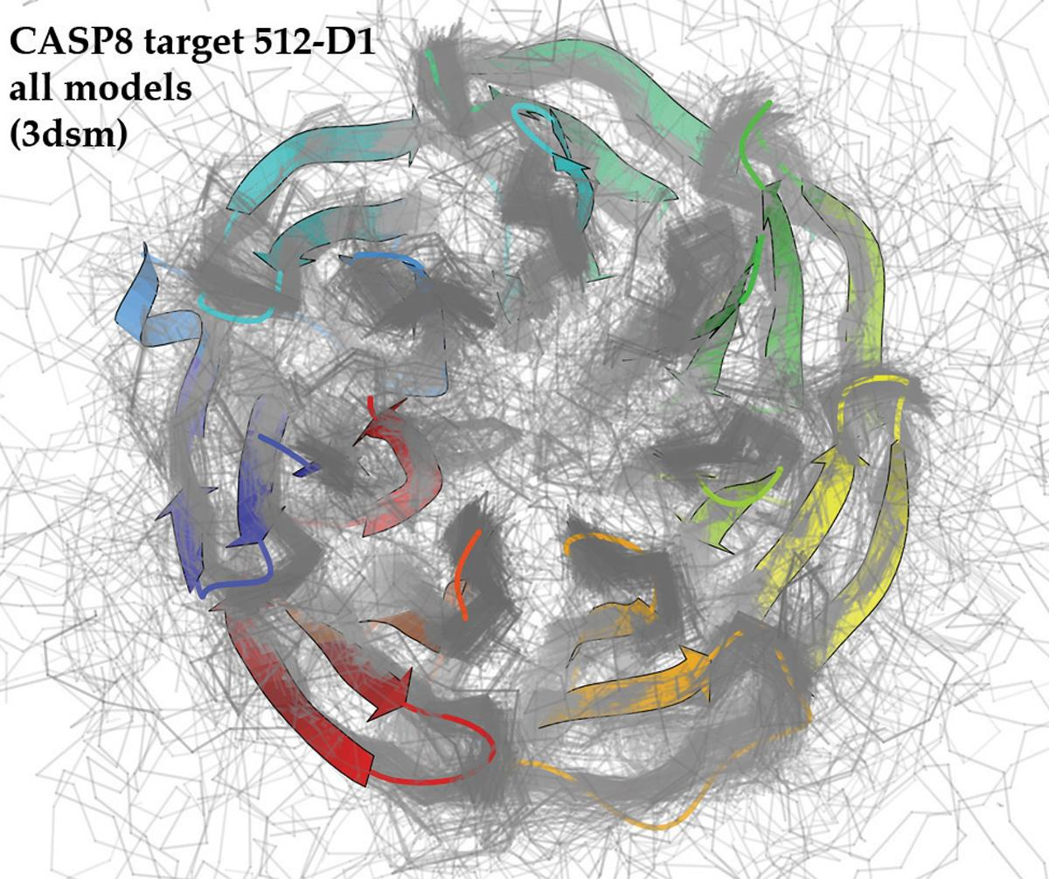

The Holy Grail of structural biology – structure prediction from sequence
CASP – Critical Assessment of techniques for protein Structure Prediction

Slide 55
Structure is more conserved than sequence

Slide 56


Slide 57

Structure is more conserved than sequence

Slide 58
Hypothesis
Conserved structure and function can encompass an “ensemble” of related sequences
Can we predict structure and function from a sequence ensemble?
What principles govern conservation beyond sequence?
What is the minimum sufficient information to uniquely describe a protein fold or function?

Slide 59

Coevolution

Slide 60

Co-evolutionary signal carries information

Slide 61

Co-evolutionary signal carries information

Slide 62

Thanks to cheap DNA sequencing!

Slide 63


Slide 65
How to score co-evolution?

Slide 66

Causative vs transitive correlations (inverse Ising problem)

Slide 67
Various methods
Correlation coefficients (e.g. Pearson’s)
Difference between observed and expected patterns of data distribution (OMES)
Mutual information based (various)
Alignment perturbation (e.g. statistical coupling analysis – SCA)
New generation of global methods:
Protein sparse inverse covariance (PSICOV)
Direct coupling analysis / direct information (DCA/DI)
Mean-field approximation (mfDCA)
Pseudo-likelihood maximisation (plmDCA, GREMLIN)
Gaussian approximation (gDCA)
Machine Learning based approaches
CNNs, ResNets, AlphaFold

Slide 68

Early success story: membrane protein structure prediction

Slide 69


Slide 70

Evolutionary couplings reveal function

Slide 71




Slide 72

AlphaFold

Slide 73

Richard Feynman’s famous “last words”
“What I cannot create, I do not understand.”

Slide 74

The future: computational protein design

Slide 75
References
Databases: https://doi.org/10.1007/s12033-010-9372-4
Proteopedia: http://proteopedia.org/wiki/index.php/Main_Page
PDB resources: https://pdb101.rcsb.org/learn/guide-to-understanding-pdb-data/methods-for-determining-structure
Extra reading for “novelty/cool” research directions:
Coevolution: https://www.nature.com/articles/nbt.2419
De novo design: https://www.nature.com/articles/nature19946
Structure prediction & design: https://www.nature.com/articles/s41580-019-0163-x

Slide 76
Questions for the supervisions
A structural model on its own is not very informative. Discuss this statement with reference to a variety of structural bioinformatics databases and resources.
How does the experimental pipeline or choice of technique for structure determination impact the quality and validity of the structural model?
(2018 exam) Protein structure models are only as good as the methods used to generate them. Discuss this statement in relation to experimental techniques, homology modelling and de novo structure prediction.
(2019 exam) For the following questions assume you can only rely on bioinformatics tools and no new experiments.
Given the amino acid sequence of a protein, describe the steps you would take and the tools you would use to learn about its secondary and tertiary molecular structure. [60%]
Subsequently, a structural model of the same protein is published. Describe how you would first check if the model is reliable, and then how you would compare it to your predictions from a). Describe the steps you would take and the tools you would use. [40%]

Slide 77
Lecture slides and practical material
github.com/alexeymorgunov/structbioinfo

Slide 78
Thank you!
Have any questions, comments?
Email me: alexey@manifoldresearch.com

